Slide 1
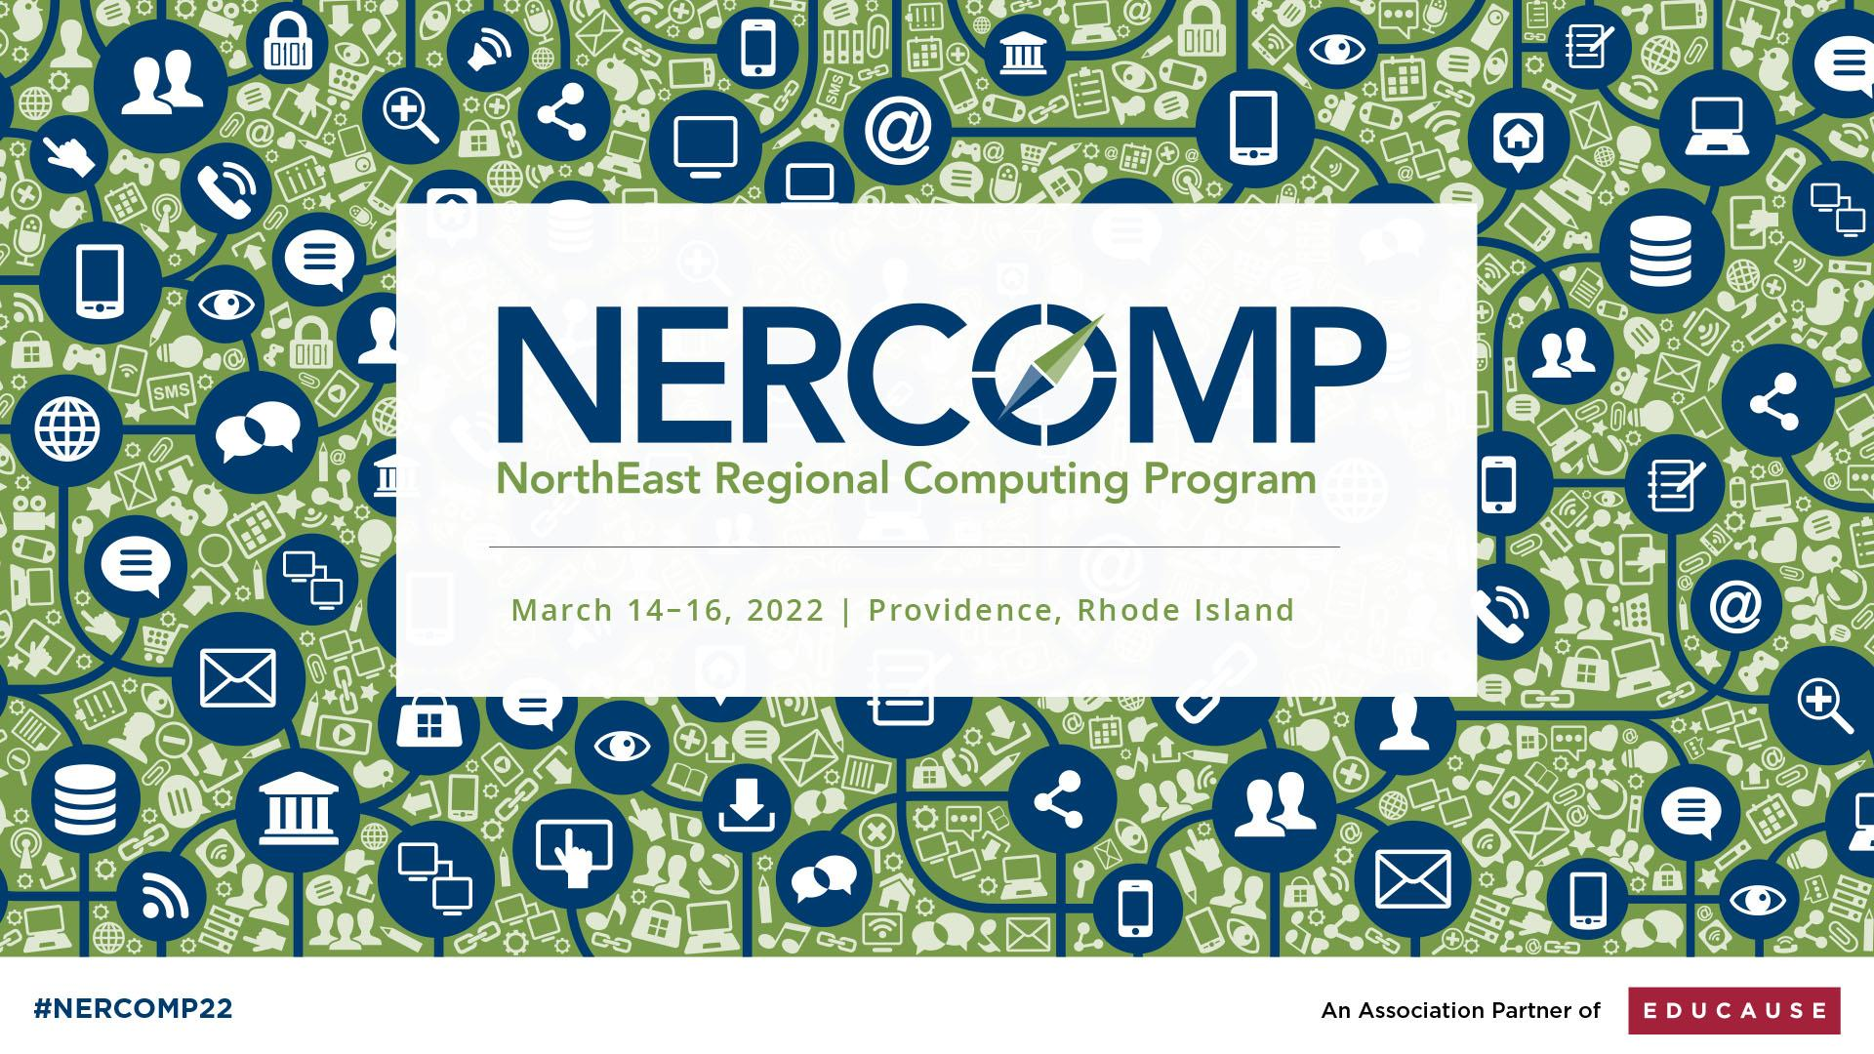
#NERCOMP22

Slide 2


Back to the Future: How LTI Advantage Enables the Boutique LMS Charles R. Severance, SakaiLMS.org Joshua Wilson, Longsight, Inc.
`
#NERCOMP22

Slide 3
Show of Hands
Running Canvas, Blackboard, or Brightspace?
How many LMS transitions since 2000?
Would you like to avoid an LMS transition for at least five years?
#NERCOMP22
Notes:
SD

Slide 4



Innovation Conundrum
Most Faculty
Upload PowerPoint
Have some due dates
Don't move my cheese
Campus IT
Simplicity
Stability
Scalability
Cost
A Few Faculty
I have an idea...
I want to teach using...
Is there a feature that lets me..
Can we add a feature?
#NERCOMP22

Slide 5

Future of Learning Summit
`
#NERCOMP22

Slide 6
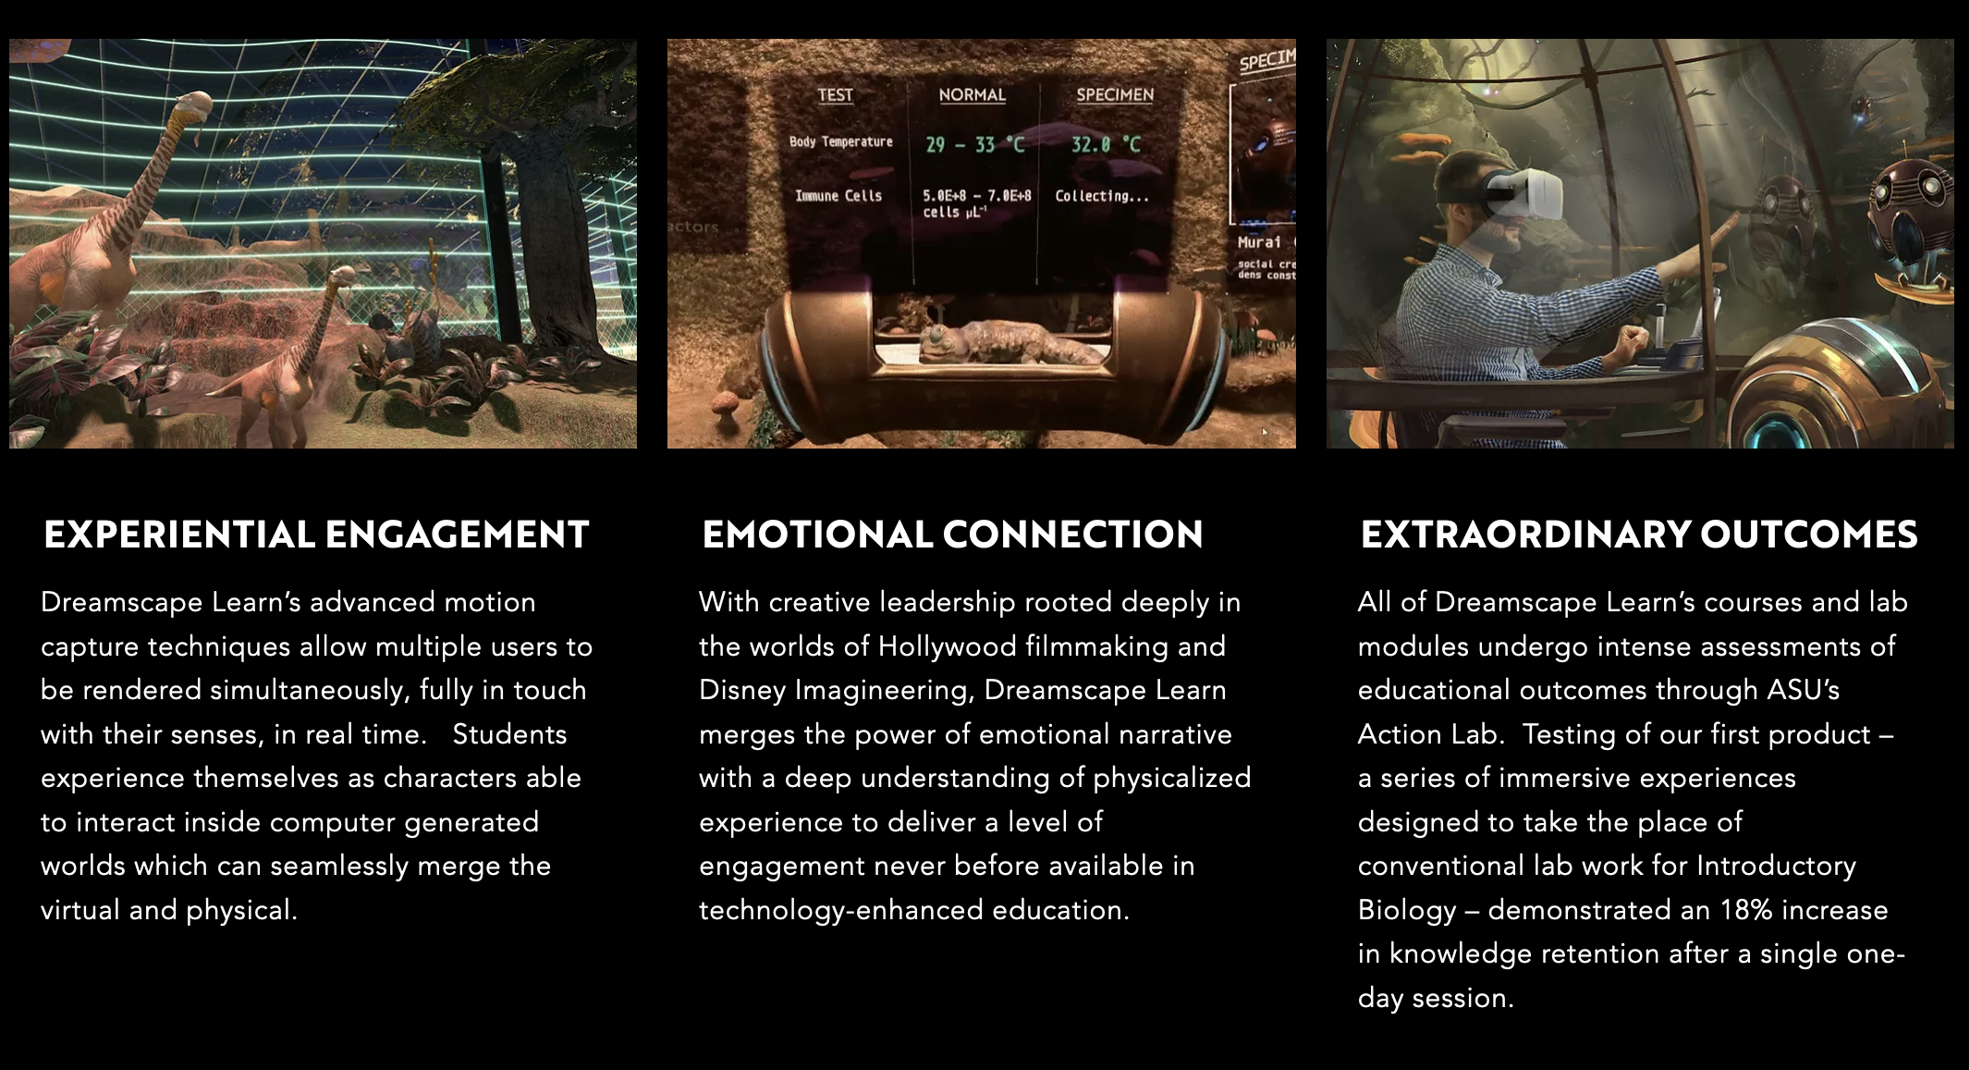
ASU Dreamscape Learn
`
#NERCOMP22

Slide 7
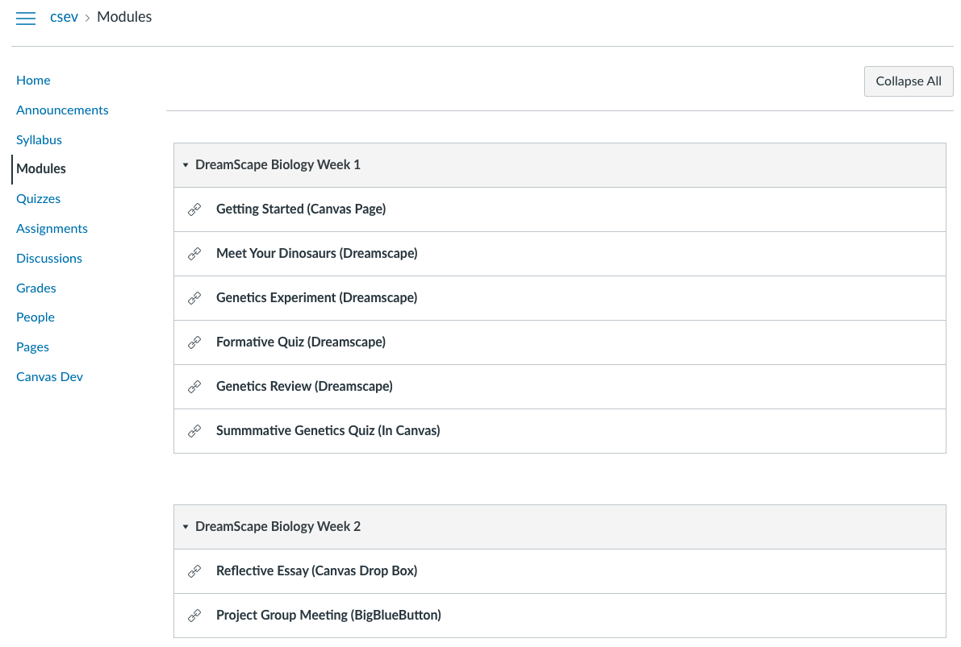
Dreamscape in Canvas
`
#NERCOMP22

Slide 8
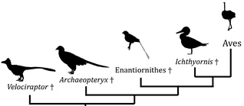
Evolution of the LMS
Roster
Gradebook
Reflection
Essay
Drop Box
Summative
Must Watch
Exercise
Forum
Q/A
Reflection
Assignments
Essay
Drop Box
Quizzes
Formative
Summative
Videos
Must Watch
Optional
LTI 1.1 Links
Reading
Exercise
Roster
Gradebook
Reflection
Essay
Drop Box
Summative
Must Watch
Exercise
Launch
L T I
A
D
V
A
N T A G E
Roster
Gradebook
Reflection
Essay
Drop Box
Summative
Must Watch
Exercise
Forum
Q/A
Reflection
Assignments
Essay
Drop Box
Quizzes
Formative
Summative
Content
Reading
Exercise
Videos
Must Watch
Optional
SIS
Roster
Gradebook
Reflection
Essay
Drop Box
Summative
Must Watch
Forum
Q/A
Reflection
Assignments
Essay
Drop Box
Quizzes
Formative
Summative
Videos
Must Watch
Optional
Roster
Gradebook
Reflection
Essay
Drop Box
Summative
Must Watch
Forum
Q/A
Reflection
Assignments
Essay
Drop Box
Quizzes
Formative
Summative
Gamified
LMS
L T I
A
D
V
A
N T A G E
Launch
Roster
Gradebook
Reflection
Essay
Drop Box
Summative
Must Watch
Exercise
L T I
A
D
V
A
N T A G E
Virtual
Reality
LMS
Locally hosted
Max Privacy LMS
Scenario-based
LMS
L T I
Tool
Reading
Exercise
Coursera
An LMS
Pilot
#NERCOMP22

Slide 9
LTI Advantage
Roster
Gradebook
Reflection
Essay
Drop Box
Summative
Must Watch
Exercise
Launch
L T I
A
D
V
A
N T A G E
Roster
Gradebook
Reflection
Essay
Drop Box
Summative
Must Watch
Exercise
Forum
Q/A
Reflection
Assignments
Essay
Drop Box
Quizzes
Formative
Summative
Content
Reading
Exercise
Videos
Must Watch
Optional
Portal
SSO
SIS
Record
Launch
Deep Linking
Names and Roles
Assignments and Grades
Pedagogy
and User Experience
#NERCOMP22
Notes:
SD

Slide 10
A Pluggable 2025
Gamified LMS
Max Privacy LMS
Coursera / edX
VR LMS
Scenario-based
Your "next" LMS
SIS
Gamified
LMS
L T I
A
D
V
A
N T A G E
Launch
Roster
Gradebook
Reflection
Essay
Drop Box
Summative
Must Watch
Exercise
L T I
A
D
V
A
N T A G E
Virtual
Reality
LMS
Locally hosted
Max Privacy LMS
Scenario-based
LMS
Coursera
An LMS
Pilot
#NERCOMP22
Notes:
SD

Slide 11
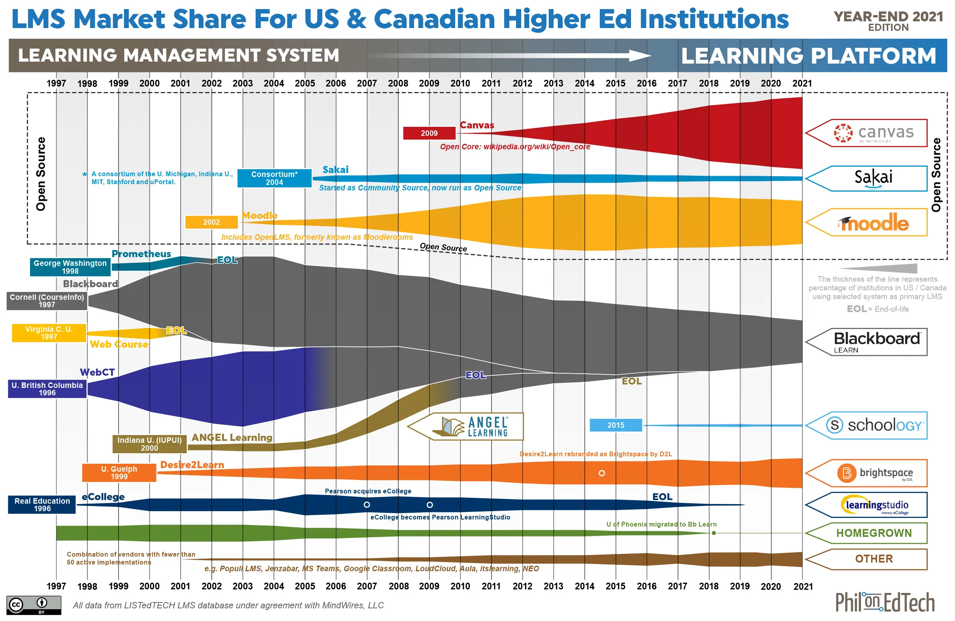
LMS Squid Diagram 2021
`
#NERCOMP22

Slide 12
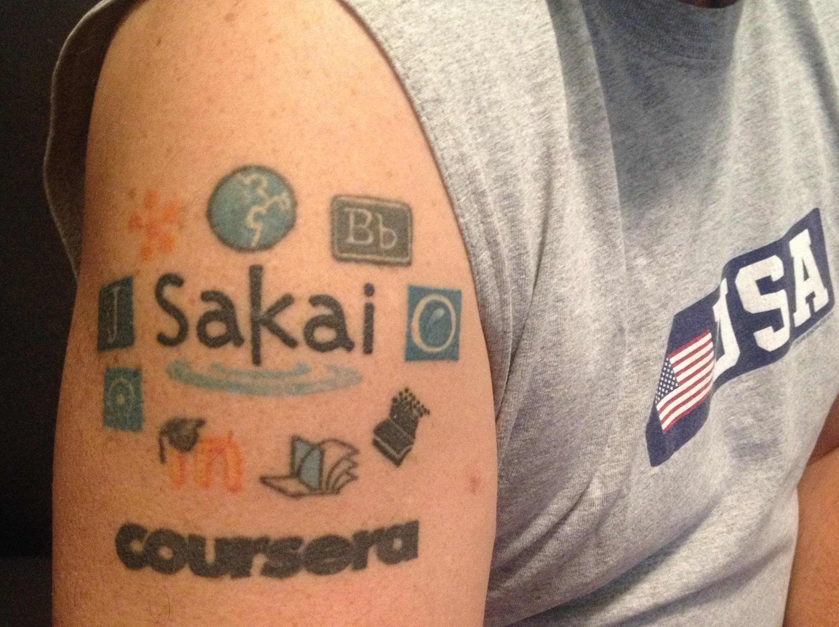
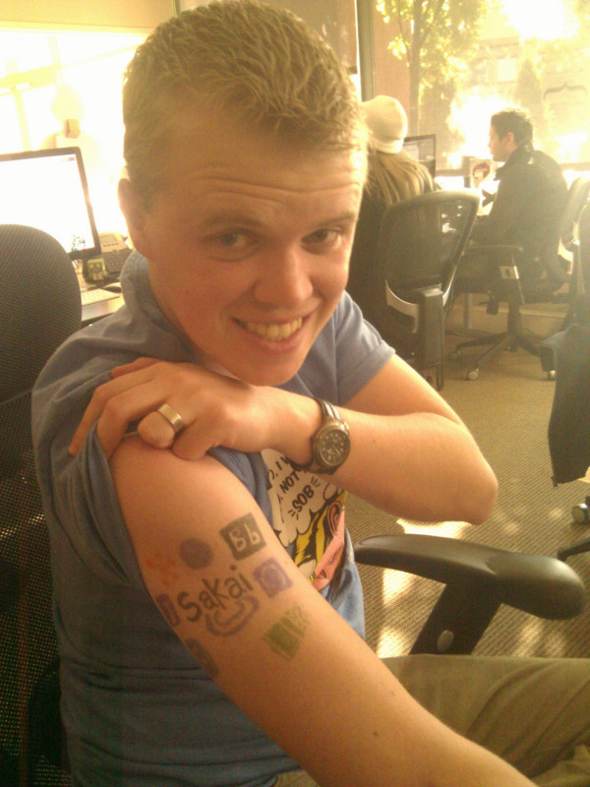
SakaiLMS.org R/D Impact
Founded IMS Learning Tools Interoperability WG in 2005
Founded IMS Common Cartridge WG in 2006
Provides open-source reference implementations
Free test platform for LTI advantage
Extensive mentoring of LTI Tool Providers
#NERCOMP22
Notes:
SD

Slide 13
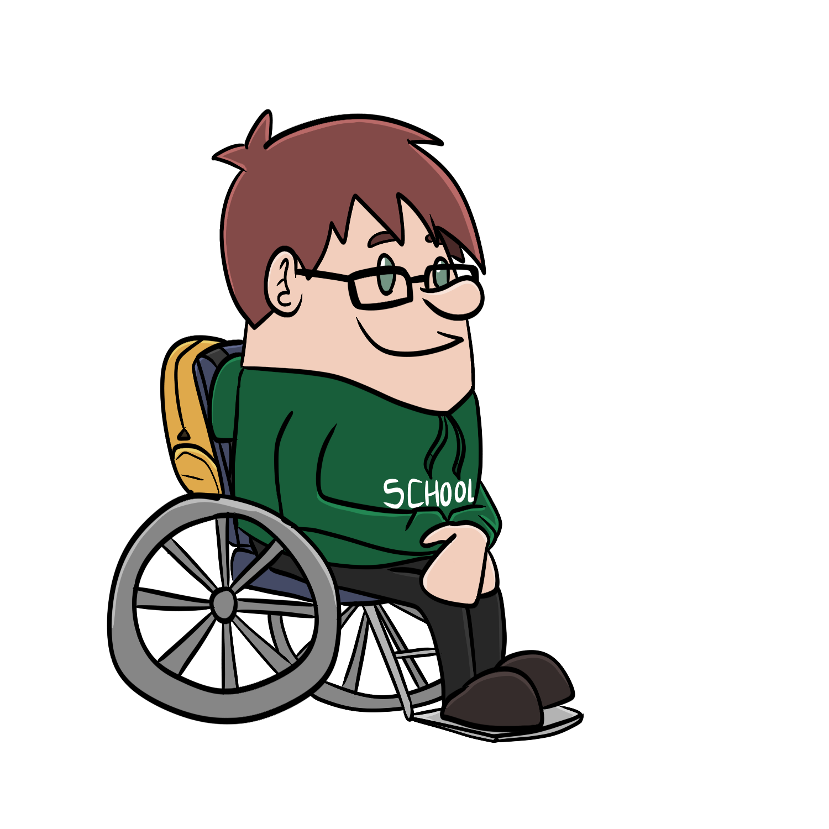



Student
Information
System
Canvas
Blackboard
Brightspace
...
LTI Advantage
SSO / Launch
Synchronized roster
Synchronized grades
Deep Linking
#NERCOMP22

Slide 14

Advantage: SakaiLMS.org
`
#NERCOMP22

Slide 15
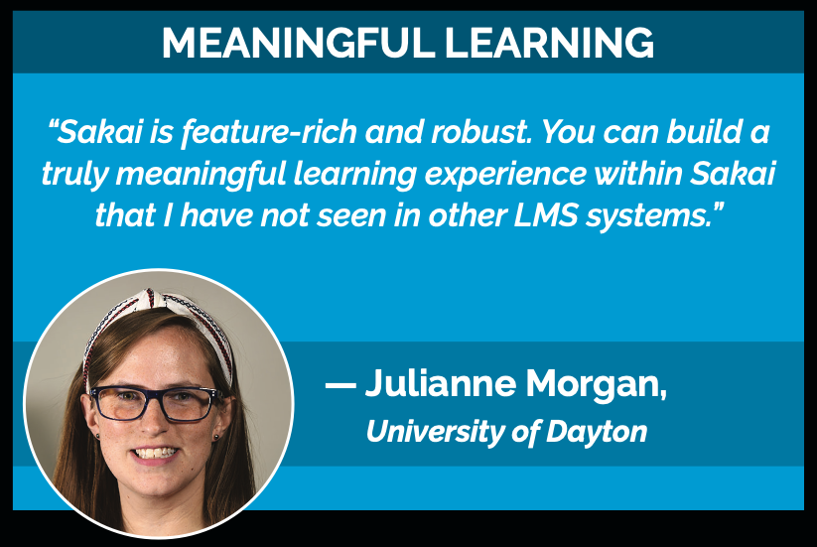

Slide 16
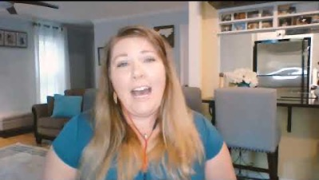
Meaningful Learning
Sakai enables deep student learning.

Slide 17
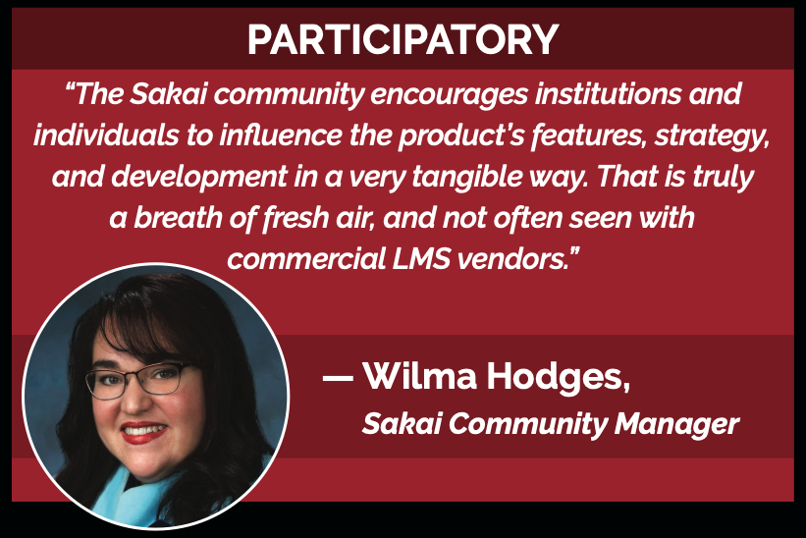

Slide 18

Participatory
Sakai’s Roadmap…
Innovative, Responsive, and Open.
Want to learn more?
Visit bit.ly/Sakai-Open-Roadmap

Slide 19
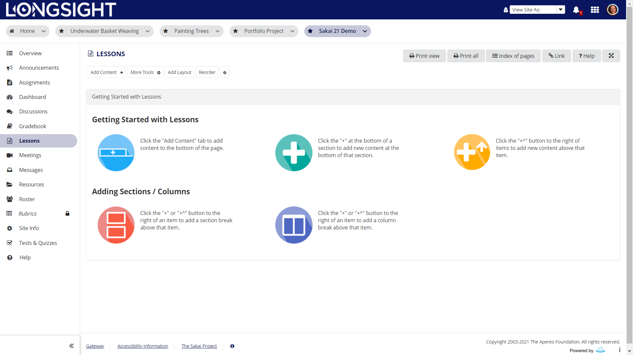
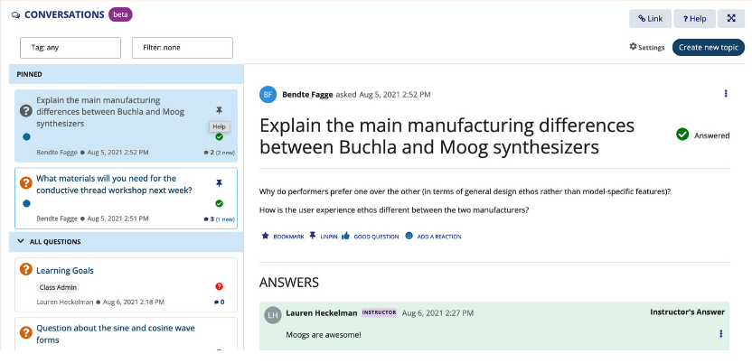
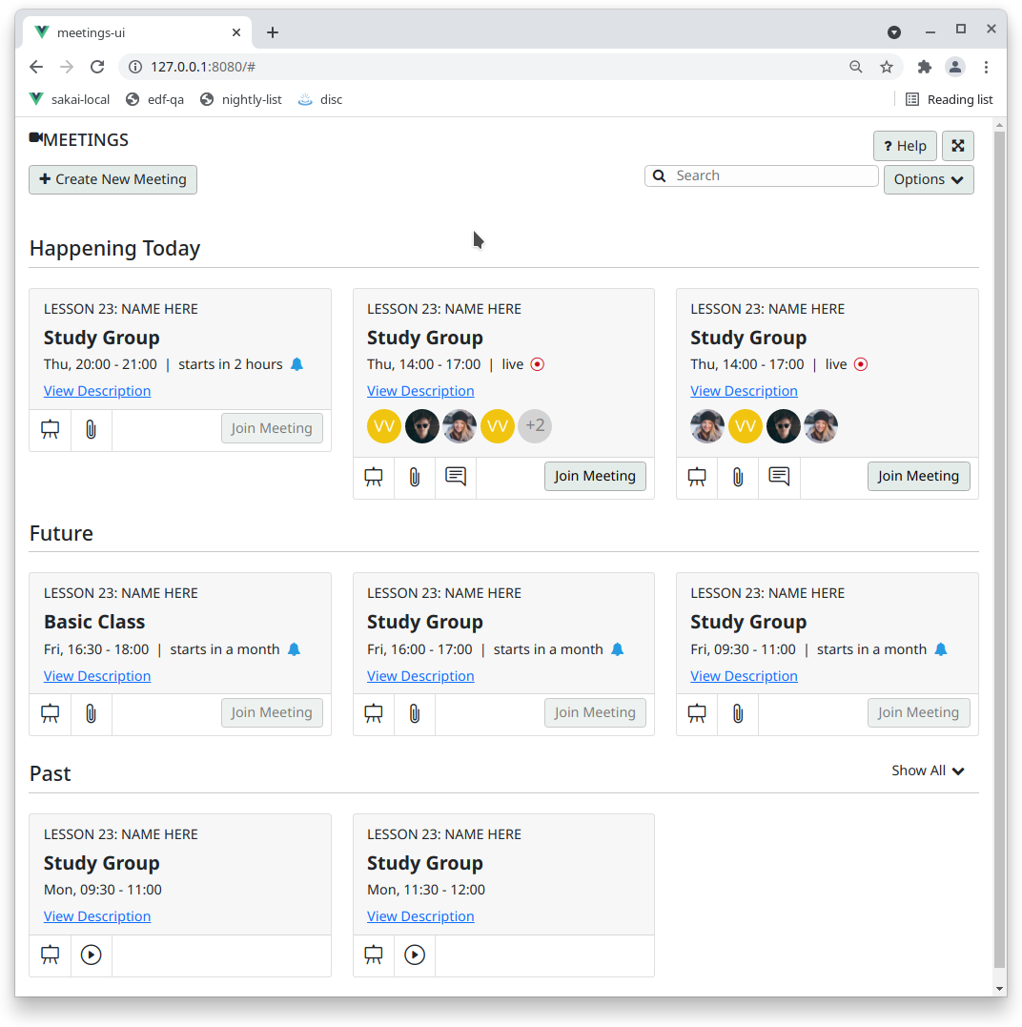
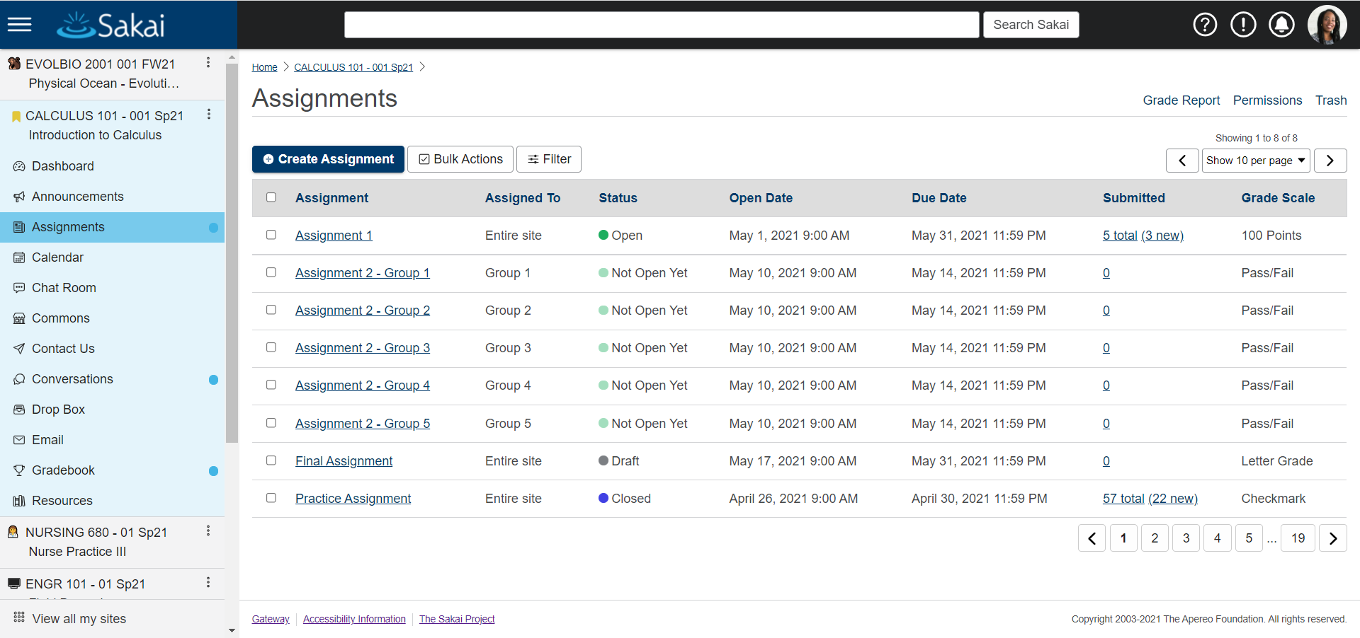
Participatory… and Delivering
Advanced content authoring [Lessons]
Engaging discussions [Conversations]
All-new user experience
Easy interpersonal connections [Meetings]

Slide 20
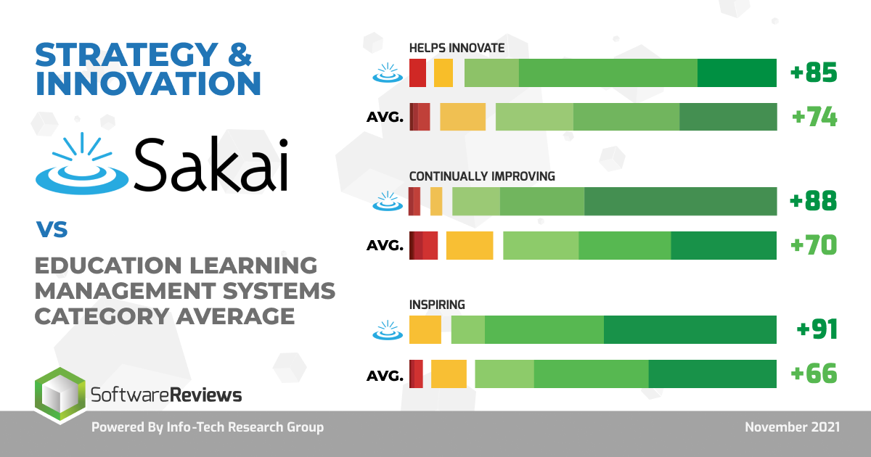
Most Innovative

Slide 21
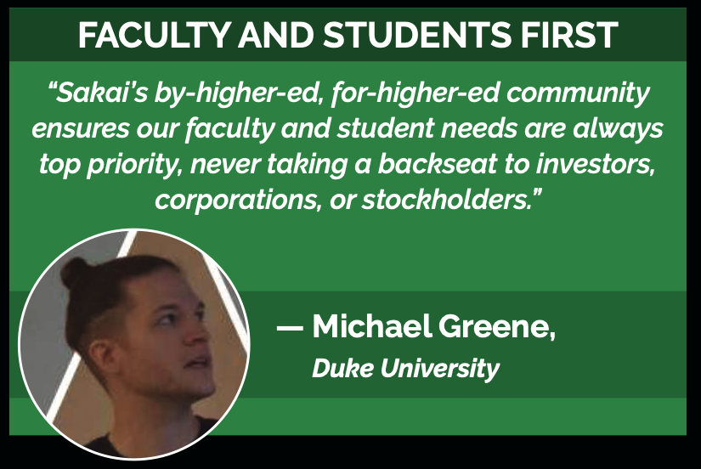

Slide 22
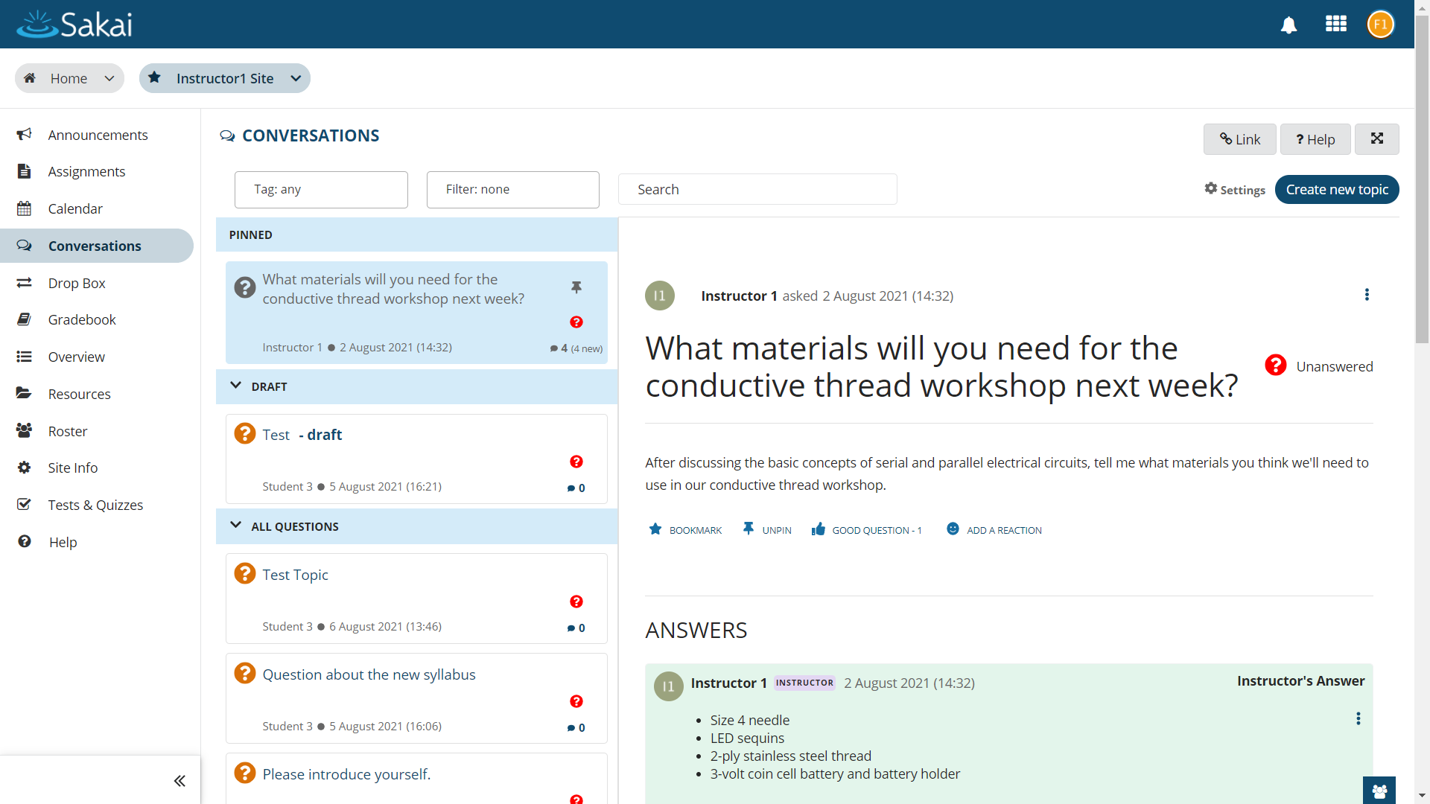
Faculty & Students First
Sakai innovates by incorporating actual input from faculty and students.

Slide 23


Slide 24
Wide Range of Sakai Services
Expert
Consultation
Managed services in your data center
Cloud
hosting

Slide 25



Sakai leadership since 2005 ◉ 100 institutions hosted ◉ Deep expertise and a personal touch
“[Longsight] exemplifies one of the best relationships we’ve had with a vendor. They’re collaborative in nature and they’re responsive….”
–Alan Regan, Director
“At Illinois State University, we are very thankful to have had Longsight as our partner for many years. Our Sakai environment is strong and stable due in part to their efforts.”
–W. Todd Smoak, Interim Executive Director
Notes:
First, let me say a few words about Longsight. I was at Brandeis University previously for 12 years in an IT leadership role, and that institution never had a service provider like Longsight. We’re leaders in the Sakai Community, with 100 institutional clients, and a huge depth of expertise. Everyone on our team has 10+ years of experience working with Sakai, and several have been around since the beginning. I’m the new guy, with 4 years at Longsight. We’re also small, with minimal turnover. When you work with us, you know the name of everyone in the company, and we know your team. It’s unusual and unlike any other provider I’ve encountered.
—-----------
Leading Sakai commercial affiliates.
Each active with Sakai since 2005.
Collaborators since 2012.
Together, host ~100 colleges and universities, including some similar in size to UCT.
Hosting clients -- Longsight.
Illinois State University. 21k students.
Brock University. 19k students.
Duke University. 15k students.
Integral part of Sakai Community.
Nearly half of Sakai management team (PMC). 6 of 15 PMC member represented.
Lead in key areas: Overall community alignment, Internationalization, Marketing, Product, Release, Security.
Deep Sakai expertise & functional knowledge.
Combined: Many decades of Sakai experience.
We’ve worked in higher education, so we understand your needs.

Slide 26
Sakai Plus Demo
`
#NERCOMP22

Slide 27
Contact Information
SakaiLMS
www.sakailms.org
SakaiPlus
Questions: plus@sakailms.org
Sign up for beta plus.sakaicloud.com
#NERCOMP22
Notes:
SD

